Slide 1

Working with Azure Resource Manager
Without going mad
@4c74356b41

Slide 2
What is Azure Resource Manager?
Deploy
Organize
Control Access

Slide 3
Terminology
Resource
Resource Group
Resource Provider
Resource Manager Template

Slide 4
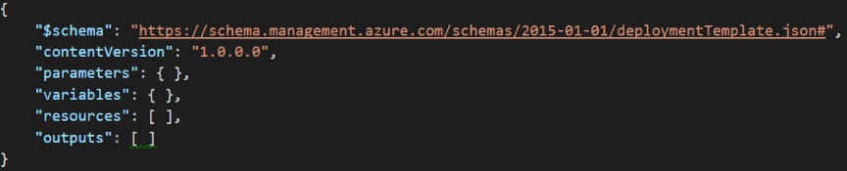
ARM Template Basics
Complete\Incremental
Syntax
Schema

Slide 5
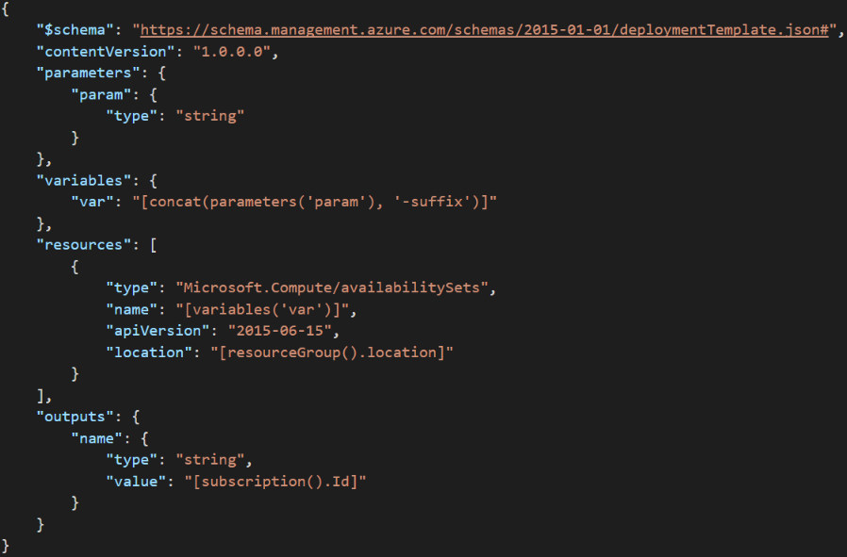

Slide 6
Main Challenges
Scattered
Portal
Powershell
Information
Inconsistent Documentation
Documentation by examples
Azure Xplat Cli
Azure Cli 2.0
Python\.NET\Java Ruby\Node.js\PHP SDK
Rest API calls
Scarce documentation (apart from Microsoft stuff)
No free support (Almost)
Templates

Slide 7
Good to know tools
Fiddler
Rest API clients (postman, insomnia, armclient, etc)

Slide 8
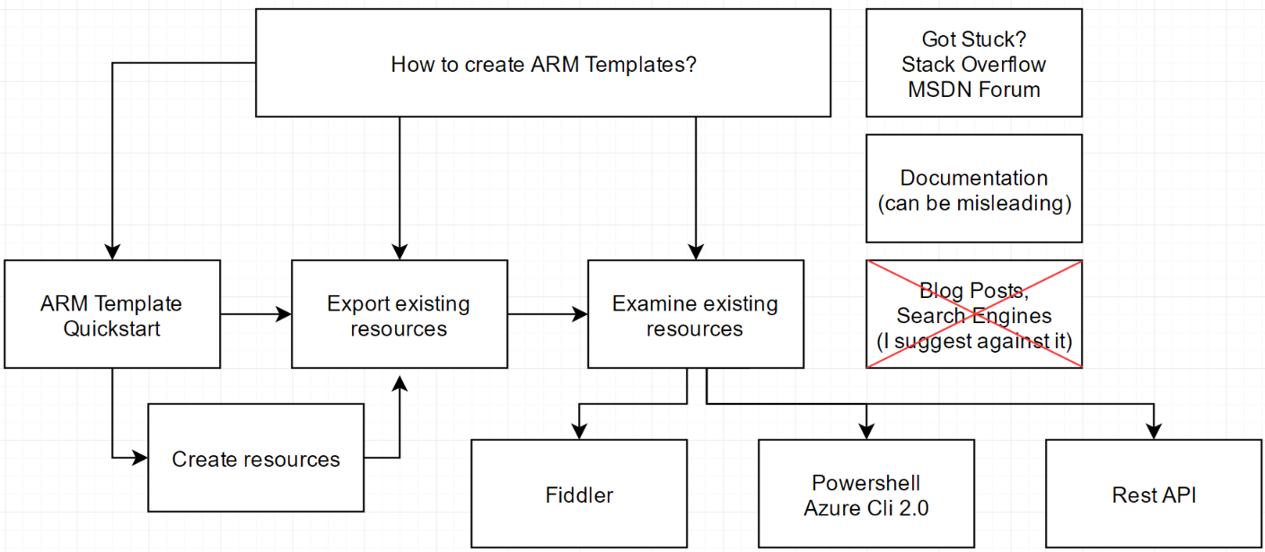
Your ARM Template workflow

Slide 9
Demo
Portal
ArmClient
RestApi
Powershell
Templates
Good to know
things,
Automation
General ideas
where to look at
Advanced syntax,
Nested deploys,
Tips and Tricks
Overview
Examples
Tips and Tricks,
Good to know
things

Slide 10
¿Questions?

Slide 11
Reference
Azure Resource Manager overview
ARM Template functions reference
Azure Template Examples GitHub Repo
ARM Schemas: bad, interactive, complex
Best Practice for complex solutions
Troubleshooting Deployments
Azure SDK’s
Azure CLI
Azure CLI 2.0
ARM Client
Azure Powershell
Azure Preview Portal
ArmViz.io
Examples used in this Talk
Powershell Put Example
Azure One Liners

